Slide 1
B.A 4th semester
Paper-4016
Environmental geography and disaster management

Slide 2
DISASTER-MEANING AND TYPES
The Disaster Management Act, 2005 (DM Act, 2005) has given a definition for disaster.
Disaster is a catastrophe, calamity or grave occurrence in any area, arising from natural or man-made causes.
It may result in substantial loss of life or human suffering or damage to, and destruction of, property or environment.
Disaster would be of nature or magnitude as to be beyond the coping capacity of the community of the affected area.
A disaster is an emergency of such severity and magnitude resulting from various uncertainties such as multiple deaths, injuries, illness, and property damage, and often not handled with routine procedures and resources. Such uncertainty can occur for several reasons. The causes can be natural, human error, equipment malfunction, disease, biological danger, etc.

Slide 3
The duration of disasters can range from a minute of disruption to an hour, day, or a week, and the effects can go from minor to large scale. These disruptions caused by various disasters can damage human resources, economic resources, environmental supplies, and even the lives of multiple species, including humans. Although any disaster type may occur for a specific period, it will have long-term effects that are usually beyond the affected society's tolerable capacity.
Types of Disasters
There are many types of disasters and can take different forms. However, all these can be broadly classified into the following three categories:
Natural Disasters
Human-made or Technological Disasters
Complex Emergencies

Slide 4
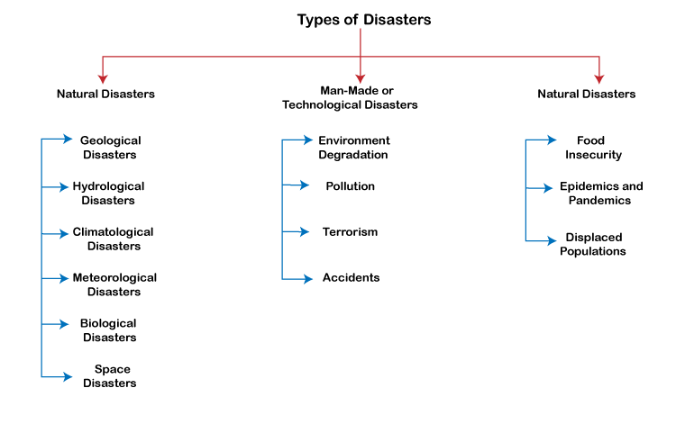
Source-wikipedia

Slide 5
Natural Disasters
Natural disasters are defined as a natural event that occurs slowly or rapidly and causes immediate widespread devastation on human health leading to death and suffering. Some biological activities, such as rainfall, can also turn into natural disasters when they occur above the average limit. These disasters are mainly characterized by various factors such as their intensity or magnitude, area of the range, duration, speed of onset, etc.
Natural disasters are also harmful to natural resources. They often cause mass destruction. Such disasters harm humans and other species. For example, a natural disaster like wildfire destroys the environment and loss of life for animal habitat. Also, it damages natural resources and property.
Besides, some natural disasters may be caused by various anthropogenic activities. For example, deforestation, mining, and agricultural activities can trigger landslides. However, they are classified in the caortegory of natural disasters.

Slide 6
Some most common types of natural disasters are discussed below:
Geological Disasters
Geological disasters refer to catastrophic events that arise due to Earth's variations, either above or below the Earth's surface. In particular, volcanic eruptions often occur where tectonic plates make contact. On the other side, earthquakes are prone to areas with active plate tectonics.
Some common examples of geological disasters include earthquakes, avalanches, landslides, tsunamis, sinkholes, volcanic eruptions, etc.
Hydrological Disasters
Hydrological disaster refers to instantaneous and violent events that occur below the Earth's surface or in the atmosphere due to variations in water quality, movement, or distribution.

Slide 7
A tsunami is a large column of water or waves mainly caused by the displacement of high amounts of water. They are usually caused by biological activities, such as volcanic eruptions or earthquakes, under the sea.
Some common examples of hydrological disasters include flooding, tsunamis, limnic eruptions, etc.
Climatological Disasters
Climatological Disasters refer to immediate and violent changes in the earth's environment related to or caused by the earth's atmosphere. It is a hazard mainly caused by long-lived/meso to macro-scale processes in the spectrum from intra-seasonal to multi-decadal climate variability. Moreover, these types of disasters can last from minutes to days. They are further classified as Extreme Temperature and Wildfire. Extreme Temperature events are identified as cold waves, heat waves, and severe winter situations (e.g., icing, avalanche, snow pressure, freezing rain, etc.). Besides, wildfire is identified as the forest fires and land fires (fires due to grass, scrub, etc.).

Slide 8
Meteorological Disasters
Meteorological disasters refer to events that are caused by extreme weather conditions, such as rain, snowfall, or drought. Disasters of this type usually affect the Earth's atmosphere and the means of the changing climate. Besides, these disasters are very destructive to the environment and can wreak havoc on many lives, including various species. Some common examples of meteorological disasters are tornados, hailstorms, and hurricanes.
Biological Disasters
Biological disasters refer to natural and unfortunate events that can cause diseases, disabilities, or even deaths at an average to a larger rate of various species, including humans and plants. Biological disasters are defined as catastrophic scenarios caused by living or non-living organisms that cause large-scale severe diseases, viruses, or infections in plants, humans, and other species. These disasters are usually caused by micro-organisms such as infectious, bacteria, toxins, viruses, etc. Some common examples of biological disasters include animal plagues and insect-borne diseases.

Slide 9
Space Disasters
Space disasters are different types of disasters. These usually involve natural actions in space, such as solar flares, airburst events, and impact events. At least once, the impact events have occurred in the history of around 4.5 billion years of the Earth. It is also said that it caused the extinction of all non-avian dinosaurs several million years ago. Solar flares are defined as the sudden release of extensively large amounts of solar radiation by the sun. Airburst events are observed as the enormous energetic explosions of rays (e.g., Gamma-ray) in distant galaxies. If such an event occurs again today, it may result in many species' mass extinction, including humans.
Human-made or Technological Disasters
Disasters can also be caused by humans, either directly or indirectly. Human-made disasters are defined as the events generated by humans primarily in, or close to, human settlements. Such events typically cause environmental or technological emergencies.

Slide 10
Human-made disasters have elements of human intent, negligence, or error that involve the human-made system's failure. Additionally, sometimes disturbances in natural resources also lead to human-made disasters. Some of the most common examples of human-made disasters include terrorism, large-scale crime or mass violence incidents, war, arson, civil disorder, biological/chemical threat, Reduction in consumption resources, etc.
Some most common types of human-made or technological disasters are discussed below:
Environment Degradation
Environmental degradation is a type of disaster involving over-consumption of natural resources, reducing the environment's ability to meet social and ecological needs. This ultimately reduces the effectiveness of ecosystem services, resulting in the mitigation of floods and landslides. In turn, the risk of natural disasters increases.

Slide 11
Pollution
Pollution is another type of human-made disaster. Although it does not show any direct symptoms, it affects natural resources and living organisms. This also reduces the environment's quality and further decreases the environment's ability to balance ecological needs. From day to day, pollution reaches significantly higher levels due to humans' large number of wastes. This leads to increased risks of disasters. Besides, when disasters occur, many of them subsequently pollute and degrade the environment.
Terrorism
Terrorism is a type of human-made disaster and is defined as incidents in which terrorists use force or violence against people or property violating criminal laws for purposes such as threats, rebellion, or ransom. Terrorism aims to create unrest within the country and spread panic among the people. Acts of terrorism typically include intimidation, murder, bombing, kidnapping, hijacking, and even cyber-attacks (obtaining intelligence and security information). Terrorists can also use chemical and biological weapons to target people at public events, gatherings and landmarks

Slide 12
Accidents
Accidents can sometimes take the form of disaster. It usually involves accidental events in which loss of life and material is measured extensively. It includes industrial, technical, and transportation-related accidents during the production, use, or transportation of hazardous materials.
Complex Emergencies
Some disasters can occur due to the impact of many disasters. Such disasters are usually classified under complex emergencies. It is generally defined as the consequences of natural and human-made disasters. In particular, complex emergencies can include the breakdown of authority, attacks on strategic installations, looting, increasing rampant crimes, many other conflict situations, or even wars.

Slide 13
The following are common characteristics for identifying complex emergencies:
Loss of many life
Extensive violence
Extreme damage to economies and societies
Displacements of populations
Increased security for humanitarian relief workers
Large scale humanitarian aid required by various agencies
Need for political and military barriers that affect or prevent humanitarian aid
Some of the most common types of complex emergencies that fall under the category of disasters are discussed below:
Food Insecurity
Food insecurity is usually defined as a secondary type of disaster. It is a threat that primarily involves incidents that cause damage to food stores and food systems. For example, natural disasters such as floods and droughts can damage agricultural infrastructure and stored food.

Slide 14
Food insecurity is usually defined as a secondary type of disaster. It is a threat that primarily involves incidents that cause damage to food stores and food systems. For example, natural disasters such as floods and droughts can damage agricultural infrastructure and stored food. Unexpected climate changes can also affect people's food sources. Because people need to consume adequate, healthy, and nutritious food at certain times of the day to live a healthy life, food insecurity leads to problems and other uncertainties. Sometimes, it can also be due to human actions, such as an unsuccessful experiment on agriculture.
Epidemics and Pandemics
The epidemic primarily involves the devastating effects of disasters caused by any disease, disability, or death of people in a particular area or community. Besides, pandemics include disasters that affect a large extent, even the entire country or the world. For example, recent coronavirus disease has been declared a pandemic by the WHO (World Health Organization). Both these disasters can be caused by nature or humans.

Slide 15
Displaced Populations
The displaced population includes people who have had to leave their residents due to disasters/ technical/ intentional incidents. People can be from the same country or refugees (people from other countries or opposite borders). This can lead to a specific emergency as there will be uncertainties to meet the basic structural needs of livelihoods. It can force people to commit crimes and other conflicts.
Classification Based on Categories
Earth, in its 4.54 billion year history, has experienced various types of disasters. Some of these disasters have led to many mass extinctions and drastic consequences for different living species. The most common types of disasters can also be classified according to the following categories:
Water and Climate Disasters: This category includes disasters such as cold waves, heat waves, hail storms, hurricanes, cyclones, droughts, cloudburst, floods, etc.

Slide 16
Geological Disasters: This category includes earthquakes, tornadoes, landslides, volcanic eruptions, etc.
Biological Disasters: This category includes disasters such as locust plagues, cattle epidemics, viral epidemics, pest attacks, etc.
Industrial Disasters: This category includes disasters such as oil spills, mine shaft fires, industrial accidents, etc.
Nuclear Disasters: This category includes disasters such as radiation poisoning, nuclear core meltdowns, etc.
Man-made Disasters: This category includes disasters such as the collapse of large buildings, fires in urban areas, forest fires, pollution, etc.
*Source-Savindra Singh,Environmental geography
*wikipedia
*UPSC materials(insights)

