Slide 1
Spatial Data Models

Slide 2
Spatial Data Models
Three common spatial data models
Vector
Raster
Triangulated Irregular Network (TIN)

Slide 3
Triangulated Irregular Networks (TIN)
A network of triangles connected together to create a 3D surface
Triangles do not cross
More complex than rasters
more efficient space-wise
Easily accommodates differing sample density
TIN preserves each measurement point

Slide 4
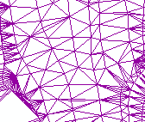
Anatomy of a TIN
Point
Edge
Face

Slide 5
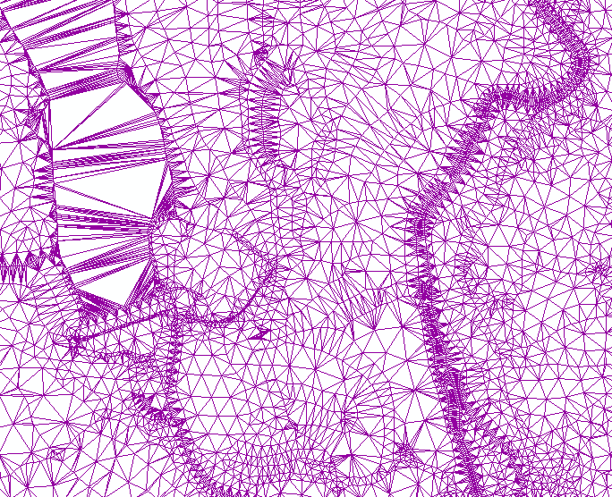

Slide 6
