Slide 1
DEFINITION OF STELE & STELER EVOLUTION IN PTERIDOPHYTES (AND HIGHER PLANTS)
TDC 2ND SEMESTER

Slide 2
Definition of Stele and Stelar System:
According to the earlier botanists, the vascular bundle is the fundamental unit in the vascular system of pteridophytes and higher plants. Van Tieghem and Douliot (1886) interpreted the plant body of vascular plants in a different way.
According to them, the primary structure of stem and roots are basically similar and the fundamental parts of each are cortex and a central cylinder known as the stele. The two are separated from each other by the endodermis. According to the proponents of the Stelar theory, the endodermis constitutes the innermost layer of cortex, and pericycle the outermost portion of stele. The stele includes not only the primary vascular tissues, but also the pericycle and pith if present. Thus the stele is defined as a central vascular cylinder, with or without pith and delimited by the pericycle on the inner side.

Slide 4
The term stele refers to the central core of plant axis and is restricted only to primary tissues.
The concept of the stele was developed in the late 19th century by French botanists P. E. L. van Tieghem and H. Douliot as a model for understanding the relationship between the shoot and root, and for discussing the evolution of vascular plant morphology.
Types of Steles:
Following types of stele are recognised on the basis of different structural organisation of the complex vascular elements.
1. Protostele:
It is the simplest and most primitive type of stele. The vascular cylinder consists of solid core of xylem surrounded by phloem, pericycle and endodermis. There is no pith e.g., Selaginella, Lycopodium, Lygodium, Gleichenia etc.

Slide 5
There are several forms of protostele:
(a) Haplostele:
A protostele with a central solid smooth core of xylem surrounded by phloem is called a haplostele. It is the most primitive type of protostele and found in primitive vascular plants such as Rhynia and Horneophyton , Lycopodium cernuum , Selaginella kraussiana , etc.).
(b) Actinostele:
This is the modification of the haplostele and somewhat more advanced in having the central xylem core with radiating ribs with phloem alternating with its rays. (e.g., in Psilotum triquetrum and L. serratum, etc.).
(c) Plectostele:
It is the most advanced type of protostele. Here the central core of xylem is divided into number of plates arranged parallel to each other. The phloem alternates the xylem (e.g., in L. clavatum and L. volubile).

Slide 6
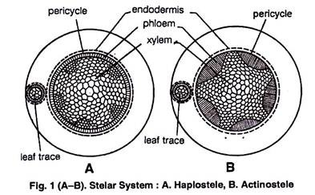

Slide 7
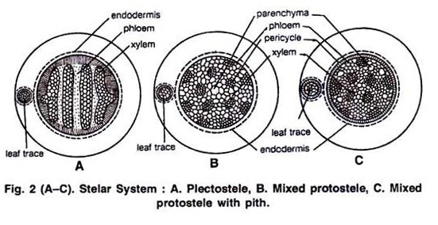
(d) Mixed-protostele :
Xylem groups are uniformly scattered in the ground mass of phloem (Fig. 2B) e.g., Lycopodium cernuum.

Slide 8
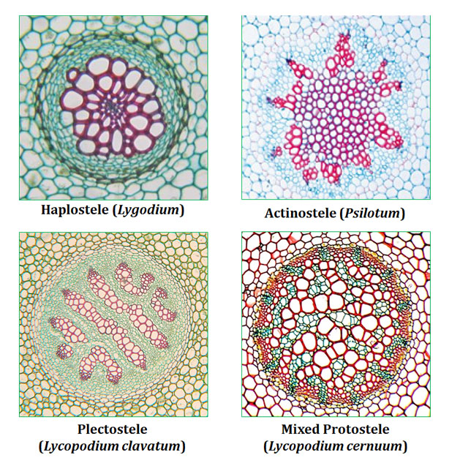

Slide 9
2. Siphonostele:
A kind of stele in which pith is present in the central region surrounded by xylem is called siphonostele or medullated protostele . In a siphonostele, the vascular tissues are arranged in the form of a hollow cylinder, with a distinct pith in the centre. This type of stele is found in ferns, gymnosperms and angiosperms.
Siphonostele is of two types:
(a) Ectophloic siphonostele, and
(b) Amphiphloic sipnonostele.
(a) Ectophloic siphonostele:
In ectophloic siphonostele, the xylem is in the form of a hollow cylinder surrounding the pith, the phloem occurring only outside the xylem as is present in (Fig. 3A) e.g., Equisetum, Osmunda, Schizaea.

Slide 10
(b) Amphiphloic siphonostele:
In amphiphloic siphonostele, the xylem forms a hollow cylinder enclosing the pith with the phloem occurring on both the inner and outer side of the xylem as is found in Adiantum and Marsilea (Fig. 3B) . In it the pith is surrounded by inner endodermis, inner pericycle, inner phloem, xylem, outer phloem, outer pericycle and outer endodermis .

Slide 11
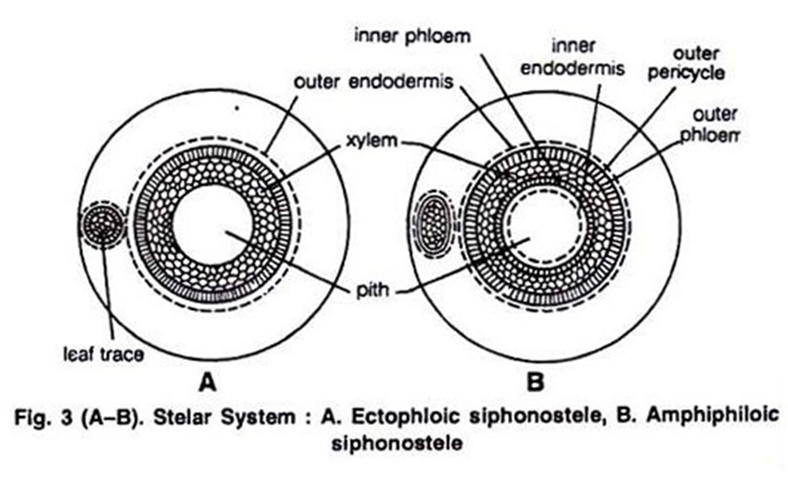

Slide 12
Evolution of Siphonostele from Protostele:
There are two main theories regarding the evolution of siphonostele from protostele:
(a) Intraxylary or Intrastelar origin:
According to this theory the siphonostele is evolved by the conversion of the central mass of the xylem into parenchymatous pith. This theory is also known as expansion theory and it is supported by Boodle (1901), Bower (1911), Gwynne-Vaughan (1903, 1914). Petry (1914), Thompson and Gewirtz and Fahn (1960) etc.
(b) Extrastelar Origin:
This theory is supported by Jaffery (1897, 1899, 1902, 1917). According to him the pith originated as a result of invasion of the parenchymatous cells of the cortex into the stele. It takes place through the leaf gaps and branch gaps. This theory is also known as invasion theory.

Slide 13
Other Modifications of Siphonostele:
(a) Cladosiphonic siphonostele:
The siphonostele without any leaf gap is known as cladosiphonic siphonstele (Jeffery, 1910) e.g.,Lycopodium and Selaginella.
(b) Phyllosiphonic siphonostele:
A siphonostele with smaller or larger leaf gaps is called phyllosiphonic siphonostele e.g., Filicophyta.
According to position of leaf gaps, two types of phyllosiphonic siphonosteles are recognised, the solenostele and the dictyostele.
(i) Solenostele:
The siphonostele which is perforated by scattered leaf traces is known as solenostele (Gwynne-Vaughan, 1907; Schoulte, 1938).

Slide 14
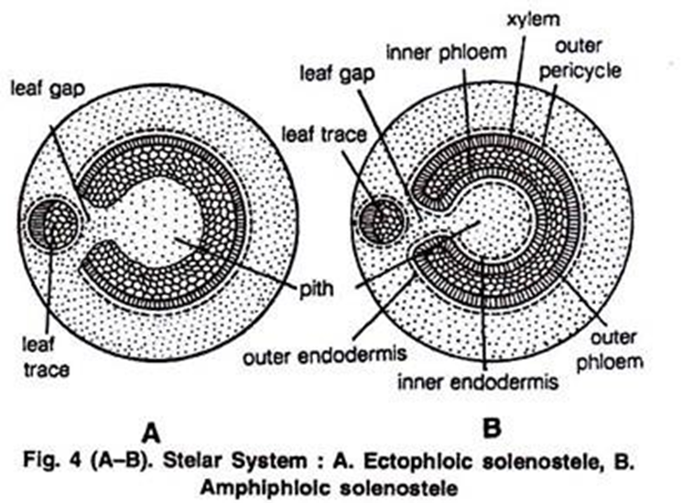
It is of two types:
(a) Ectophloic, solenostele and
(b) Amphiphloic. solenostele
(a) Ectophlopic solenostele:
Phloem is present only on outer side (Fig. 4A).
(b) Amphiphloic solenostele :
Phloem is present on both the
sides of the xylem (Fig. 4B).

Slide 15
(ii) Dictyostele:
A siphonostele with large number of overlapping leaf gaps so as to show more than interruption in one transverse section is known as dissected siphonostele or dictyostele. In cross section, dictyostele shows separate vascular strands, each called meristele. The vascular parts of dictyostele between the neighbouring leaf gaps are known as meristeles.
Each meristele is a miniature protostele which is concentric in structure, consisting of a central strip of xylem surrounded by phloem. Such a meristele is characteristic of fern rhizome (Pteris and Pteridium) and rhizome and stems of dicots and gymnosperms.Some more common examples are Pteris, Ophioglossum lusitanicum, Adiantum capillaris-veneris, Dryopteris chrysocoma etc. (Fig. 5 A,B).

Slide 16
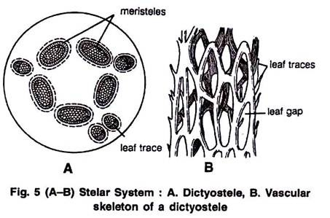

Slide 17
(c) Polycylic:
A number of separate steles are arranged in more or less regular cycles one within another. Such a condition is known as polycyclic and the stele is called polycyclic stele. e.g., Pteridium aquilinum and Matonia pectinata. In this type of stele if the outer cylinder is solenostelic it is called polycyclic solenostele Fig. 6 A) and if outer cylinder is dictyostelic it is known as polycyclic dictyostele (Fig. 6 B)
(d) Polystelic:
Two or more protosteles lie side-by-side in a stem except at branching place where all steles are connected e.g., Selaginella laevigata. (Fig. 6 C).

Slide 18
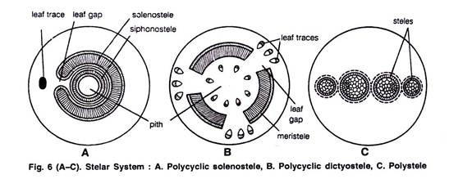

Slide 19
(e) Eustele:
According to Brebner (1902), there is one more modification of the siphonostele known as eustele. Here the vascular system consists of a ring of collateral or bicollateral vascular bundles situated on the periphery of the pith (Fig. 7 A). In such steles, the inter-fascicular areas and the leaf gaps are not distinguished from each other very clearly. The example of this type is Equisetum.

Slide 20
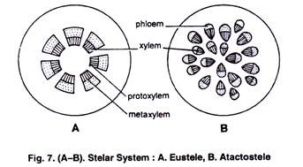
(f) Atactostele:
It is characteristic of monocots. In this type of stele vascular bundle lies scattered in the ground tissue (Brebner, 1902). It is the highly evolved stelar organisation (Fig. 7 B).

Slide 21
Evolution of Dictyostele from Siphonostele:
Ultimately the siphonostele gives rise to dictyostele. In some of siphonostelic members due to the dwarf axis, the shoot and leaves become over-crowded resulting into the formation of several leaf gaps. The vascular supply for a leaf from the main stele is called leaf trace.
The parenchymatous region left behind in the main stele after the departure of the leaf trace is called leaf gap. Similarly the vascular supply is also given to branch. Vascular supply given out for a branch from main stele is called branch trace.
The parenchymatous region left out in the main vascular cylinder due to departure of branch traces is called as branch gap forming the dictyostele (Brebner, 1902). This type of stele may further result into polycyclic condition by the formation of several rings.

Slide 22
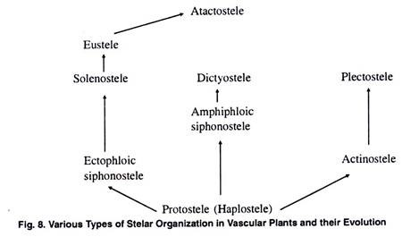
Thus, it is evident, that protostelic condition has given rise to siphonostelic, dictyostelic and ultimately to polycyclic condition during the course of evolution.

Slide 23
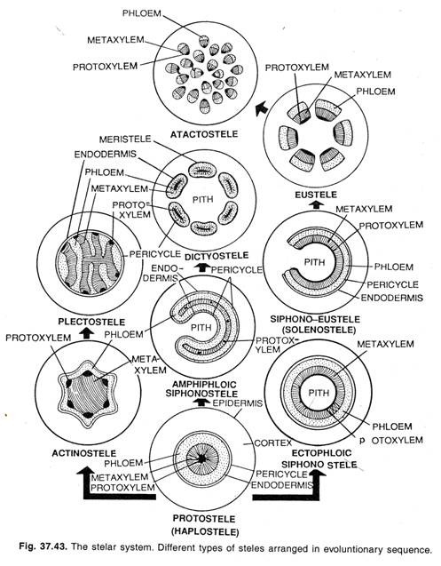

Slide 24
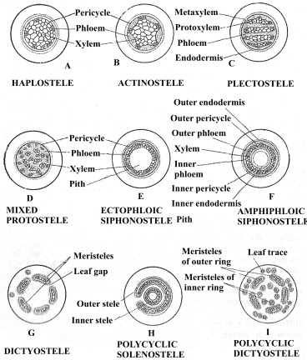

Slide 25
