Slide 1
B.A 4th semester
Paper-4016
Environmental geography and disaster management

Slide 2
ENVIRONMENTAL GEOGRAPHY:SCOPE
The scope of the study of environmental geography may be grouped into 9 major subfields.
The geoecosystem or simply ecosystem as study unit-ecosystem is the basic ecological unit for the study of various aspects of environmental geography.
Ecosystem functioning: the functioning of ecosystem including circulation of energy and matter and ecosystem productivity

Slide 3
Temporal changes in ecosystem:evolution of plants and animals and ecological succession
Ecological changes in space: it refers primarily to spatial changes in the distribution of plants and animals in the world.
Global environmental problem:it include those problems which are caused mainly by anthropogenic processes.
Environmental hazards and disasters: that include both natural and anthropogenic hazards and disasters

Slide 4
Man and environmental processes:these are significant aspects of environmental geography becaused increased human economic activities have enormously modified different environmental processes which have upset the natural ecosystem.
Environmental degradation and pollution
Environmental management: it is the most significant aspect of environmental geography

Slide 5
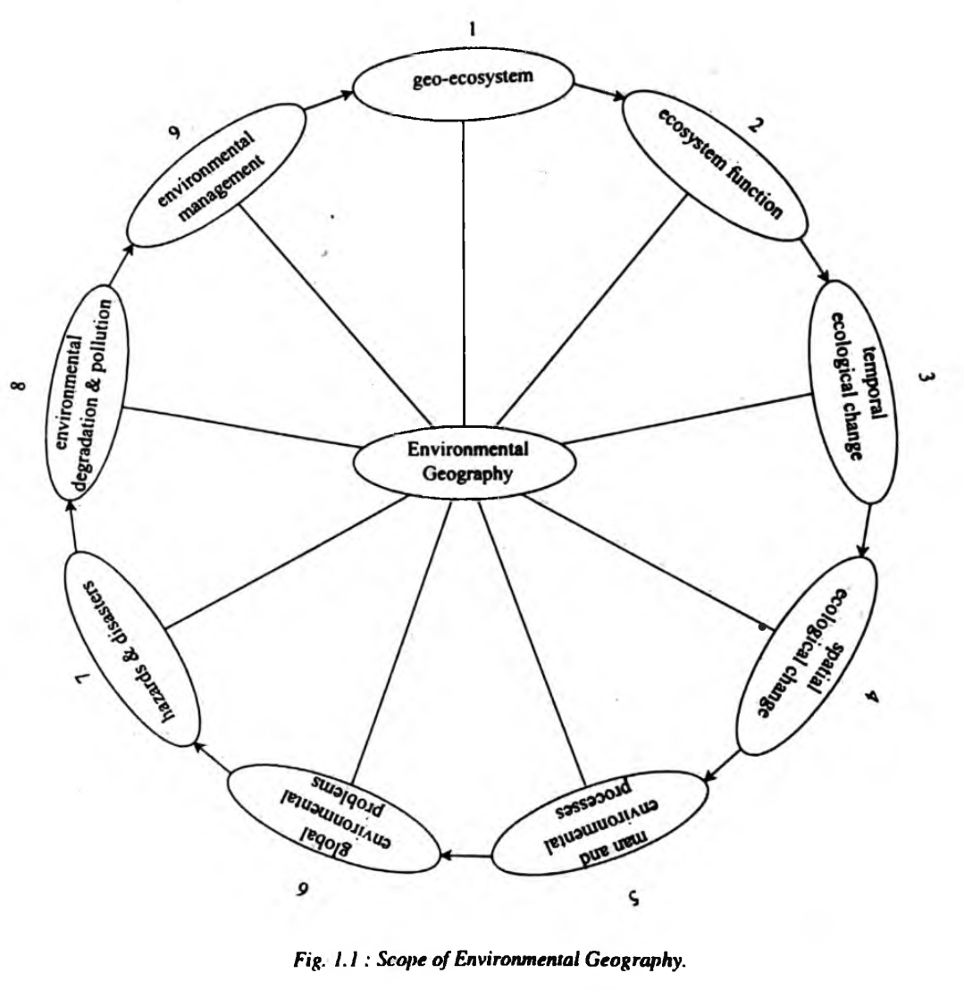
Scope of environ-mental geography
Source:Environmental Geography,Savindra sing

Slide 6
Significance of Environmental Geography
Environmental geography as a branch of geography studies about the spatial aspects of interactions between humans and the natural world.
It requires an understanding of the dynamics of climatology, hydrology, biogeography, geology and geomorphology, as well as the ways in which human societies can understand the environment.

Slide 7
Environmental geography represents a critically important set of analytical tools for assessing the impact of human presence on the environment by measuring the result of human activity on natural landforms and cycles.
It is concerned with the spatial attributes of all the phenomena related to the environment, environmental issues, resources and management
It includes the study of various biomes and human influences on them

Slide 8
Geography with ecological perspective can study man-environment relationship, identify environmental problems,
It studies about the cause- effect, severity, management and mitigation of various environment issues like Climate change, global warming, ozone depletion, habitat loss, bio-diversity loss, pollution etc.
Includes the notion of sustainable development, environment education,conservation and management.

Slide 9
It helps in formulating economically and socially sound environmental planning and management plans for the conservation of natural and ecological resources.
Bibliography-Environmental Geography by Savindra Singh
Brainly.in
Environmental Geography by Saxena
Onlinelibrary.wiley.com
wikipedia

